Slide 1
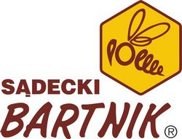
„Sądecki Bartnik”
A history about bee-garden

Slide 2
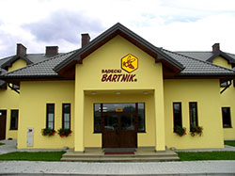
The beginnings of Bartniks
Sadecki Bartnik', which is the fulfillment of passion and life career of Anna and Janusz Kasztelewicz, was established in 1973 in Stroze. After a few initial years of gathering vital experience and hard work, since 1989 'Bartnik' started to develop dynamically and became a company appreciated not only in Poland but also in Europe and many other countries in the world. Today, its apiaries comprise of over 1500 bee families from which a wide variety of honey products is produced.

Slide 3


History of the name of the company
'Sadecki Bartnik' stands for its logo that symbolizes the long-lasting tradition of a peaceful coexistence of human with and in nature. Anna and Janusz Kasztelewicz, following the example of the ancient forest beekeepers, cherish their work that gives them so much satisfaction and devote themselves to it with exemplary diligence, honesty and respect for the world of bees. In the end, there is much truth in the saying that beekeepers are people of good hearts who derive their peaceful attitude from communing with the most noble kind of insects.

Slide 4
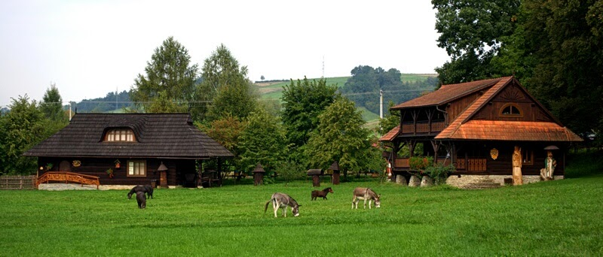
The philosophy of the company
When it comes to the logo of 'Sadecki Bartnik' it is a perfect representation of the company's philosophy. Bee, being the symbol of diligence, cleanliness, dedication and attachment, illustrates what is the most important for the Bartnik family. The individual needs of the clients are always put first making the most of the healthful properties of honey and its derivatives.

Slide 5
IN SHORT, „SĄDECKI BARTNIK”:
know the expectations of clients and they are the basis for actions
closely monitor the market and the environment and „Sądecki Bartnik” act upon their observations
adjust their processes to the demand of the market
aspire to achieve the highest quality in every area of their activity
concentrate on their strengths and they make good use of our resources
find the source of their success in the positive feedback of their clients
base their success on the competence of their staff

Slide 6
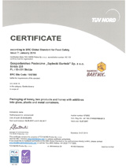


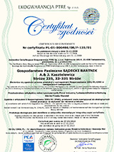
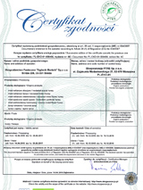
Certificates
Diligence, where products are concerned, and constant struggle for the highest quality of the offered products resulted in implementation and certification in 2002 the quality management system ISO 9001 and 14001, as well as the HACCP system.
Class A Certificate. This certificate is the guarantee for clients that 'Bartnik Sadecki' fulfills all the requirements necessary to meet the quality and health safety standards.

Slide 7
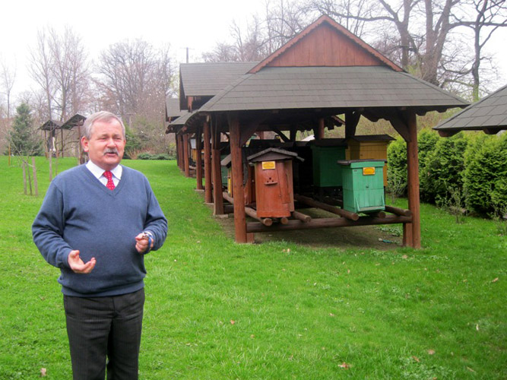
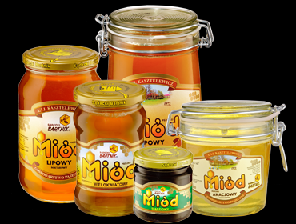
EVENTS
IN
„SĄDECKI BARTNIK”

Slide 8
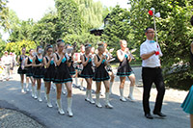
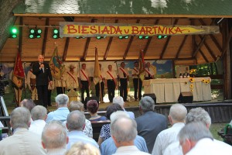
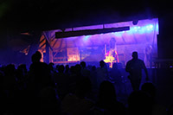
Feast at Bartnik
The first weekend of July is traditionally the time of meetings, games, attractions and good fun at Sadecki Bartnik beekeeping farm.
Beekeepers have the opportunity to participate in the conference titled: „Let's help bees – the bees will help us”. They not only have the chance to get familiar with the latest apiarian information, health and therapeutic properties of honey but there is also time for experience and views exchange and for shopping.
However, the feast usually gathers not only beekeepers but also honey fans and great fun enthusiasts.

Slide 9
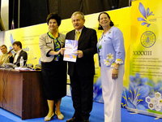
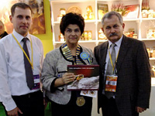
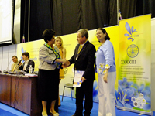
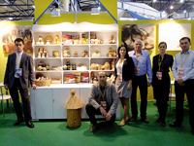
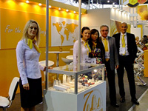
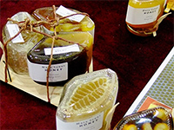
„Sądecki Bartnik” and medals
In Kiev 2013 „Sądecki Bartnik’ got bronze medals of "ApiExpo". These prestigious awards were granted for the publication by Heinrich Gritsch "No Fear of bees" and for the company's exposition stall.

Slide 10
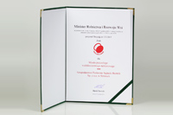
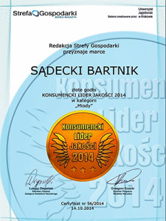
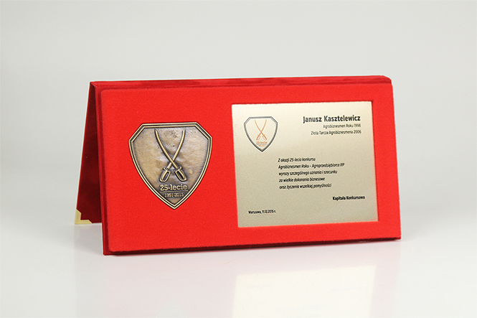
Awards
„Sądecki Bartnik” got a lot of awards.
Here yu can see some of them.

Slide 11
Silver anniversary of Agro buissnesman Contest
The chairman of “Sadecki Bartnik” Janusz Kasztelewicz was awarded with a medal of 25th anniversary of Agro businessman Contest. The award was given for outstanding business achievements.
This special event was an occasion to recall economic changes taking place in the Polish countryside and also in rural environment.

Slide 12
Polagra Food 2015
Honey from „Sądecki Bartnik’’received PDZ symbol for the fifth time!
Sadecki Bartnik honey was awarded with prestigious PDZ symbol during this year international trade fair for food in Poznan.
The company, under a new name: Gospodarstwo Pasieczne Sądecki Bartnik Sp. z o.o received orders for the following honey varieties:
multiflower honey
buckwheat honey
acacia honey
lime-blossom honey

Slide 13

Consumer Quality Leader 2014
In this edition of the program Sadecki Bartnik received the “Gold Emblem” in the category: “Honey”.

Slide 14
Prepared by:
Kacper Fik

