Slide 1
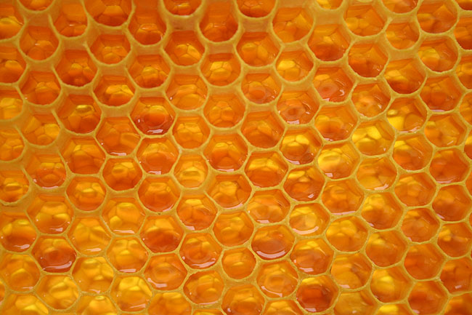
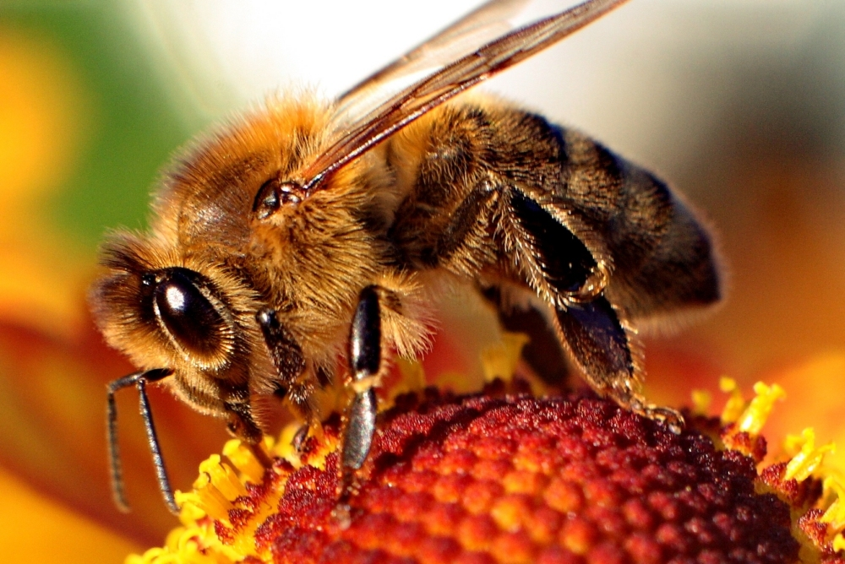
How bees make honey…

Slide 2
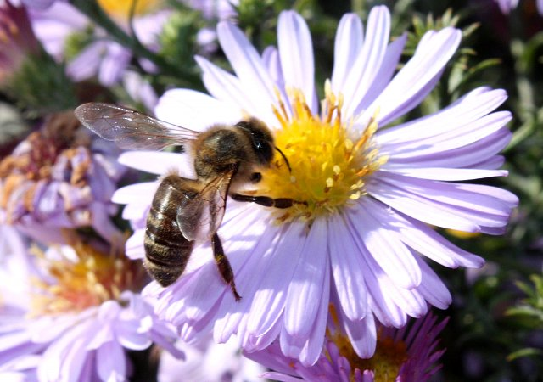
The first step
The formation of the honey begins
when the barantina bee* finds and locates the benefit(plants).
After returning to the hive the barantina bee starts to dance on the patch, which informs the other foragers bees* of direction, quantity and quality of benefit.
barantina bee- a bee who is
looking for benefit
foragers bee- the bee who collects
nectar

Slide 3
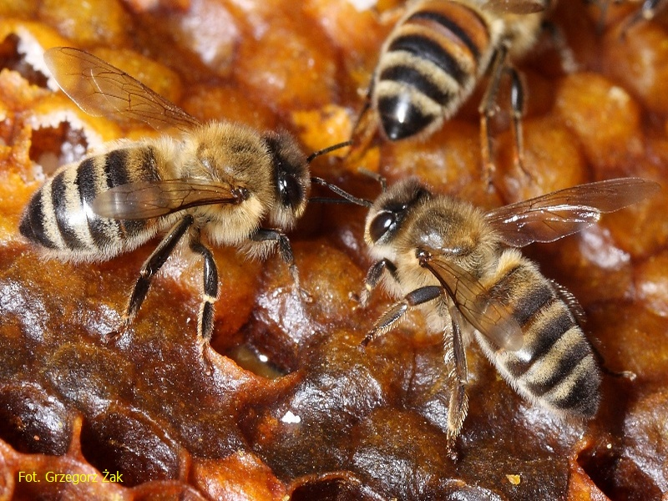
The second step
Bees foragers collect nectar in a special container* called the honey crop, and after returning to the hive give it to
a worker bee.
Honey crop- container on
bees legs

Slide 4
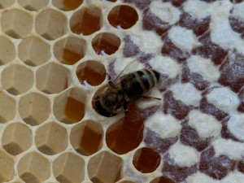
The third step
Nakrop* is stored in the cells of honeycomb, but the bees still move it from
place to place, and when honey is ready - they cover the cells with a thin layer of wax.
Nakrop-nectar collected by bees

Slide 5
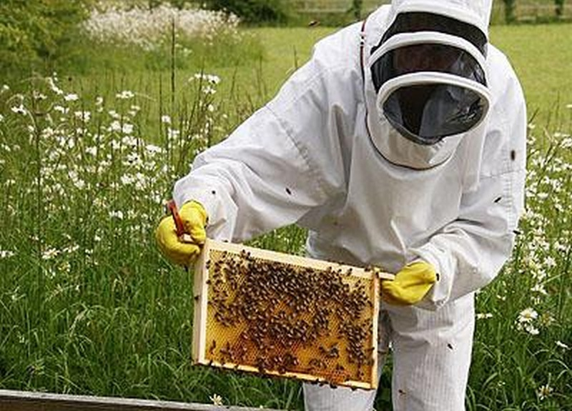
The fourth step
The beekeeper must dress up beekeeping suit, and pull out ready honeycombs from hive and carry it to the special room with honey extractor*
honey extractor- a machine to centrifuging honey

Slide 6
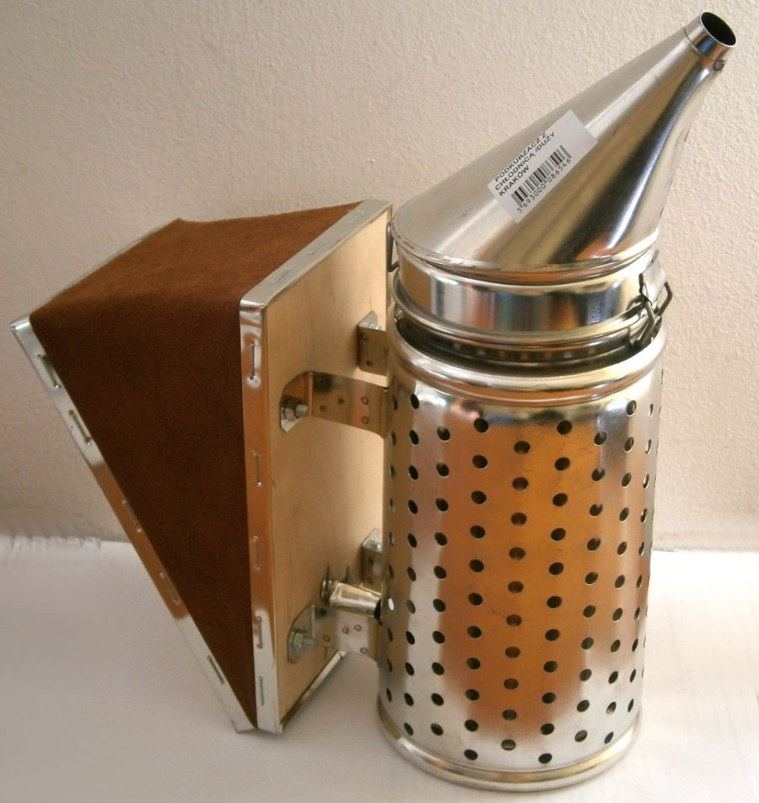
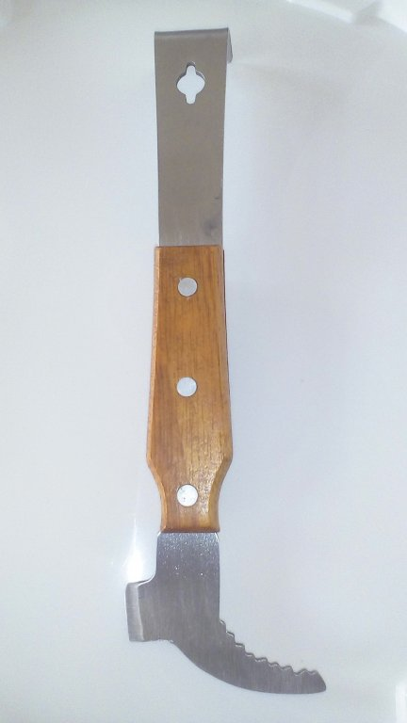
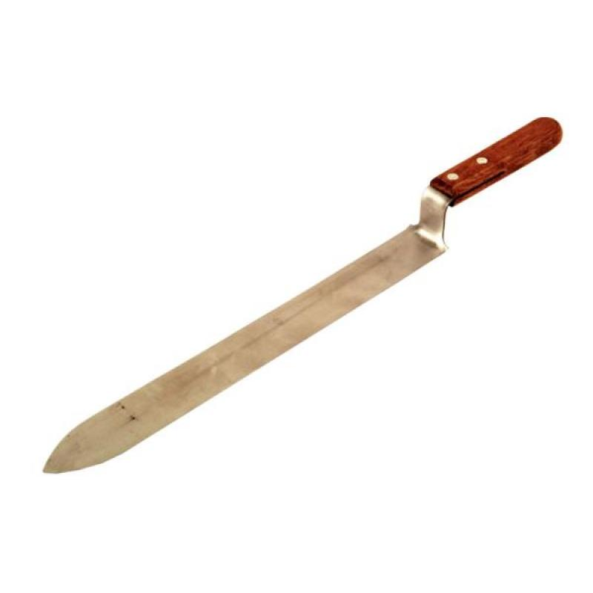
Beekeeper’s equipment
Beekeeping knife
Bee smoker
Beekeeping chisel

Slide 7
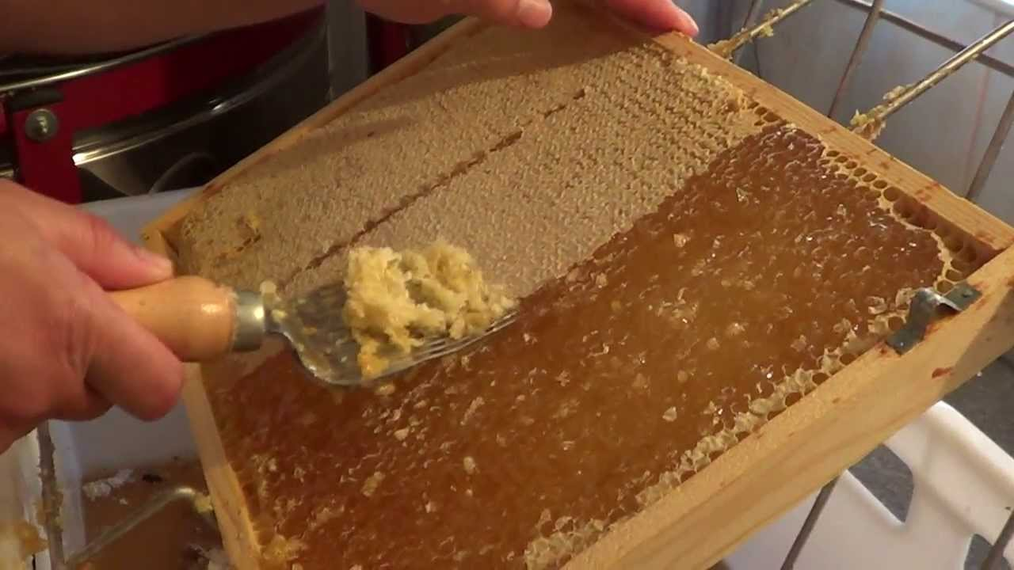
The fifth step- uncapping
Extracting honey from combs, is carried out mostly by uncapping*, and then centrifuging the honey in the honey extractor
Uncapping- removing a layer
of wax from honeycomb
honey extractor-a machine to
centrifuging honey

Slide 8
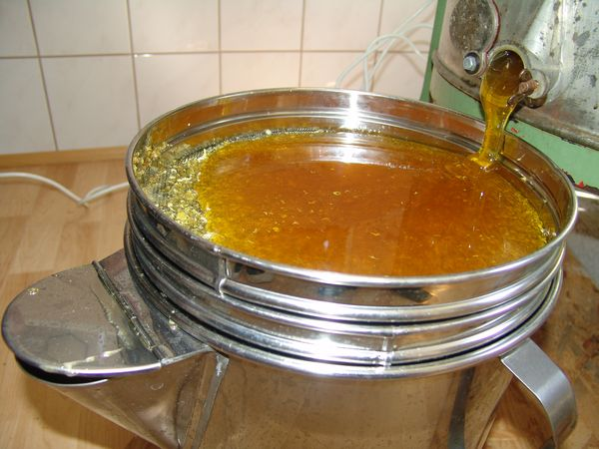
The last step
At the end honey is passed trought the sieves to remove impurities

Slide 9
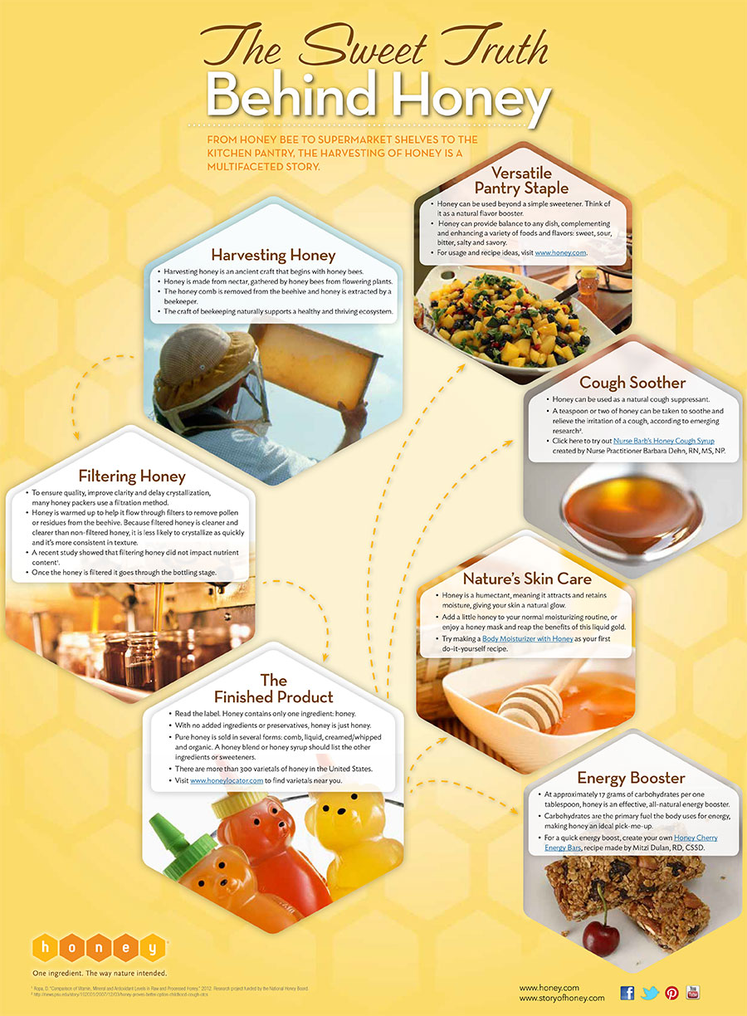

Slide 10
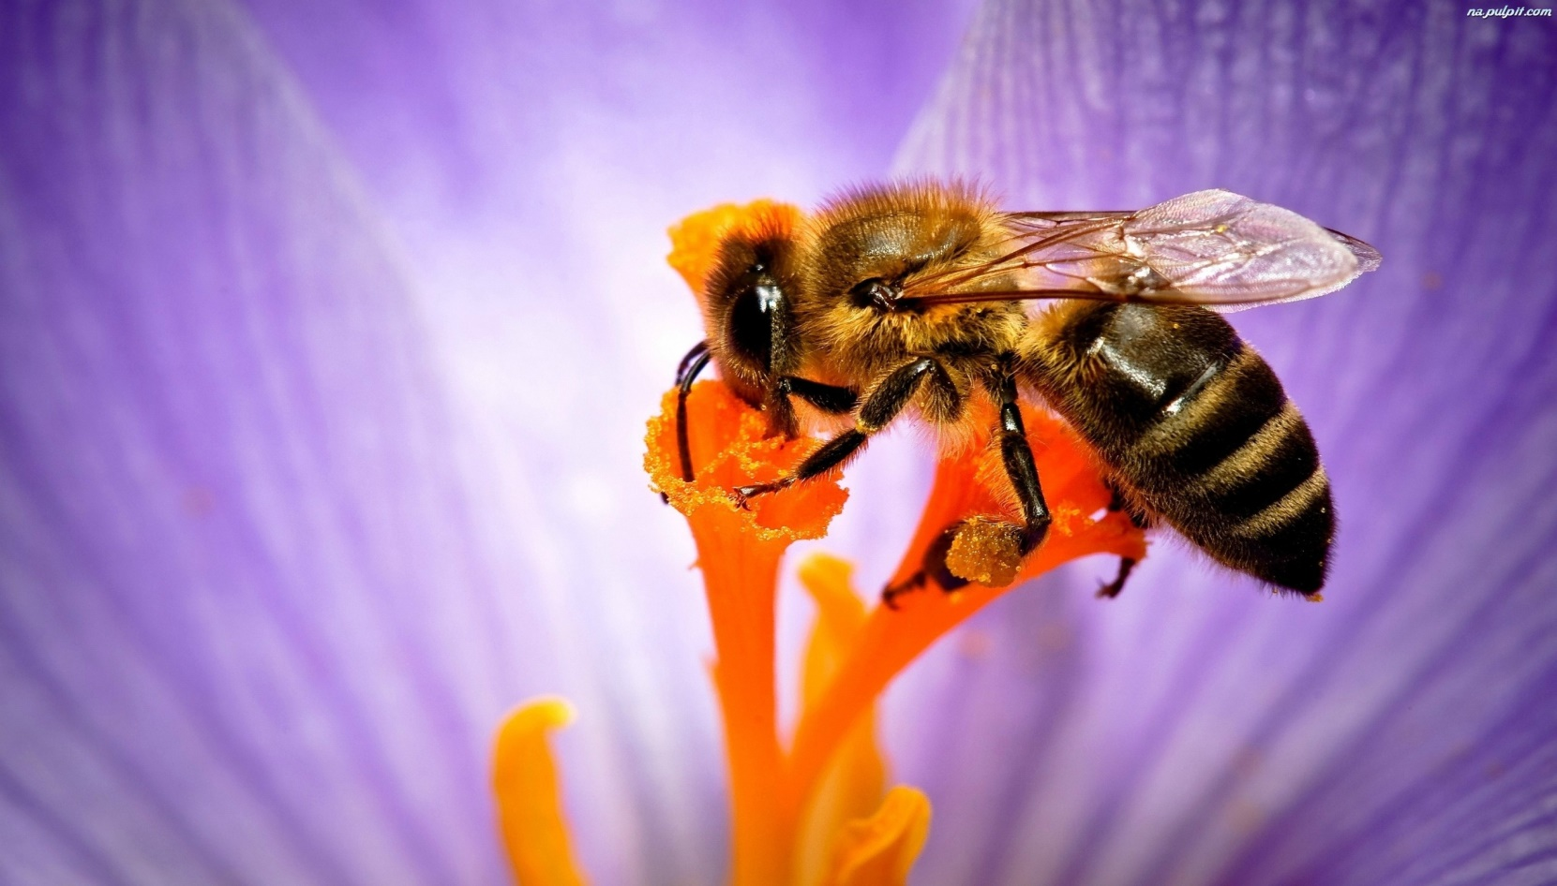
Thanks for your attention
Prepared by:
Maksymilian Ludwin

